Slide 1
The Political and Legal Environments

Slide 2
LEARNING OUTCOME:
To understand the various types of political systems
To analyse the effect of different political systems on company operations
To explain legal issues facing international companies

Slide 3
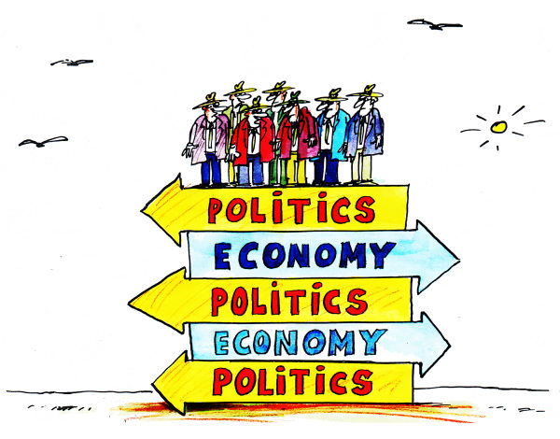
What Is A Political Economy?
Political economy of a nation - how the political, economic, and legal systems of a country are interdependent
they interact and influence each other
they affect the level of economic well-being in the nation

Slide 4
The Political Environment
A country’s political system refers to the structural dimensions and power dynamics of its government that specify institutions, organizations, and interest groups, and define the norms that govern political activities.
Political Environment is the state, government and its institutions and legislations and the public and private stakeholders who operate and interact with or influence the system.
Notes:
The goal of a country’s political system is to integrate the diverse elements of a society. A successful political system unites a society in the face of differing viewpoints. So for example, the peace and prosperity that exists in countries like Sweden and Australia illustrate the success of the political systems in those countries, while the instability and insurrection of Libya’s political system shows its failings.

Slide 5
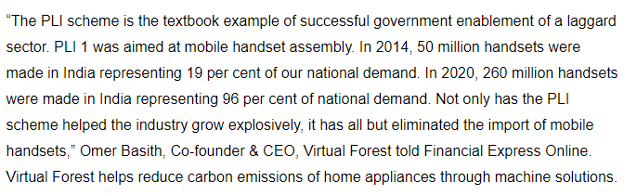
Push for the Local Manufacturing
PLI scheme

Slide 6
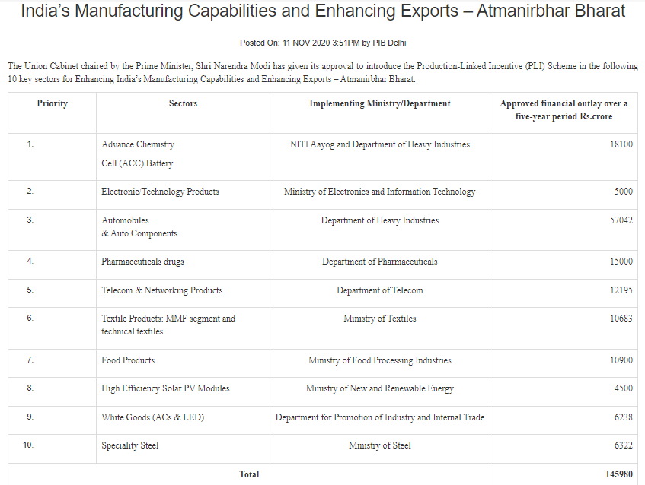

Slide 7
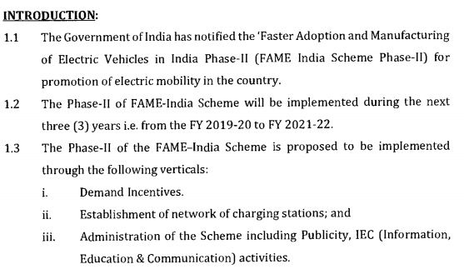
FAME I and FAME II (Phases)
What is FAME
(Faster Adoption and Manufacturing of (Hybrid &) Electric Vehicles in India)

Slide 8
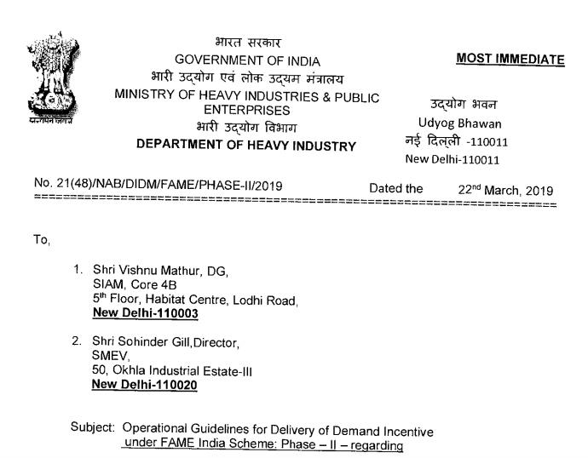


Slide 9
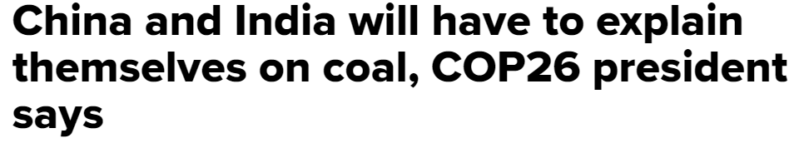
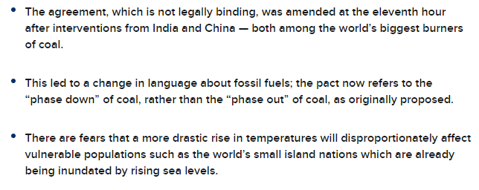

Slide 10
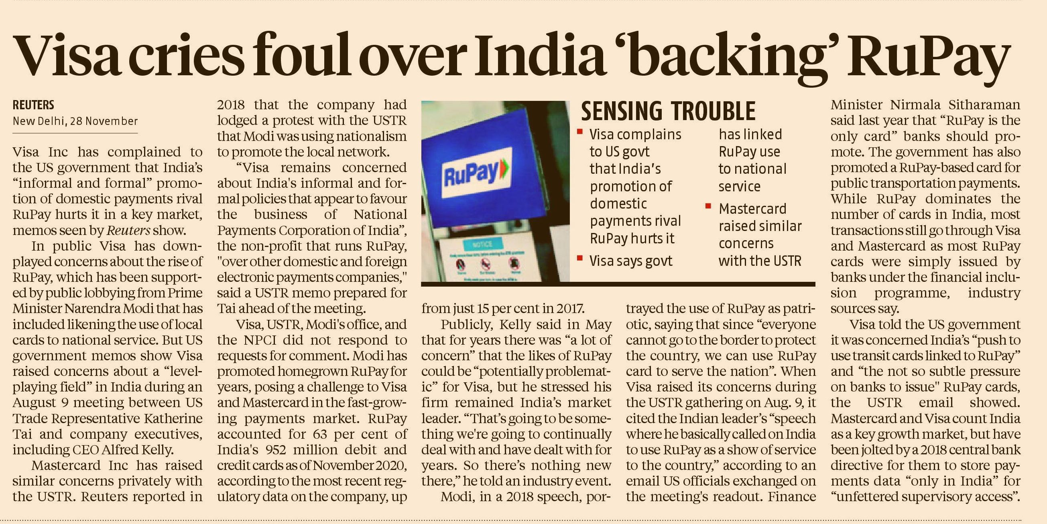

Slide 11
The Political Environment
It is assessed according to two dimensions:
Individualism vs Collectivism
Democracy vs Totalitarianism

Slide 12
Individualism vs. Collectivism
What is government priority:
Social equality or Hierarchy?
Individual liberty or collective security?
Jurisdiction in some or all areas?
Rights of citizens ?
Notes:
Individual freedom and self expression –economic self interest
Developing means and methods to subordinate individual for collective good

Slide 13
Individualism vs. Collectivism
Individualism
Primacy of the rights and role of the individual. Political parties and agencies have limited role in society.
Australia, Canada, Netherlands, New Zealand ,United States ,UK
Govt do not interfere in business activities and it promotes fair competition.
Govt. is detached from day to day practice of business
Notes:
Govt should not interfere in business activity
People regulate themselves in business activity by acting fairly n justly
Maximise personal performance without threathing the welfare of society………………opportunistic behaviour
One standard way to assess a political system is exploring the degree to which it emphasizes individualism versus collectivism.
Individualism champions the rights of the individual over those of society. From a business perspective, this suggests that managers have the right to make economic decisions largely free of rules and regulations. You might be aware that countries that have an individualist orientation shape their marketplace with the idea of laissez-faire and support the idea that government should not interfere in business affairs. Under this perspective, individuals are presumed to be self-regulating in promoting economic prosperity and growth, acting fairly and justly to maximize personal performance without threatening the welfare of society.
In contrast, collectivism encourages the government to intervene to improve the welfare of the group at the expense of the individual. For business, this means that the ownership of assets, the structure of industries, the conduct of companies, and the actions of managers must improve the welfare of society. Therefore, group members accept the responsibility for making decisions that will benefit everyone. Countries taking a collectivist orientation hold that government will intervene in market situations to ensure that business practices benefit society.

Slide 14
Individualism vs. Collectivism
Collectivism
primacy of the rights and role of the community, class, society or nation over individual interests
Argentina, China, Vietnam, Japan, South Korea, Brazil, Taiwan, Mexico and Egypt.

Slide 15

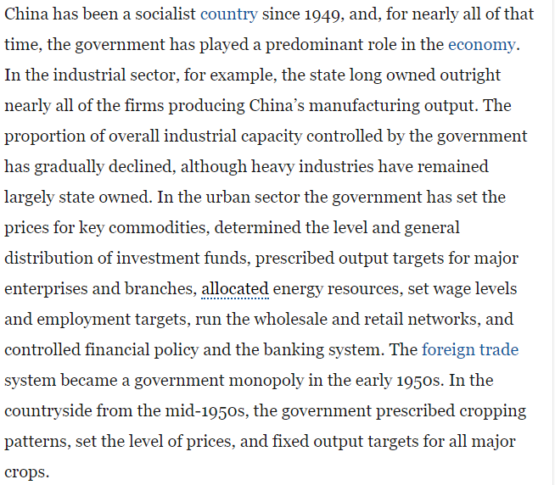

Slide 16
Collectivism
Businesses conduct the activities for the benefit of society where Govt regulates the market to promote:
Social equality
Labour rights
Income equality
Workplace democracy

Slide 17
Ex. China Govt officials intervene in the structure of industries ,conduct of companies and actions of managers such that it benefit society.
Ex. Saudi Arabia political leaders limit property rights and control mass media to regulate business environment.

Slide 18
Democracy
Of the people,by the people,for the people
all citizens are politically and legally equal
all are equally entitled to freedom of thought, opinion, belief, speech, and association
Voting citizenry have power to alter the laws and structure of the government.
Notes:
Understanding the ideals and means of democracy and totalitarianism can help explain the other points on the political spectrum. Democracy calls for participation by citizens in a fair and just decision-making process. Since it supports individualism, companies can make investment and operational decisions based on economic rather than political standards. Under a democracy, commerce and trade is promoted.

Slide 19
Features of Democratic Political System
Freedom of opinion, expression, press and freedom to express
Elections in which voters decide who to represent them
Limited terms of elected officials
An independent and fair court system with high regard for individual rights and property
A nonpolitical bureaucracy and defense infrastructure
Citizen accessibility to decision making process

Slide 20
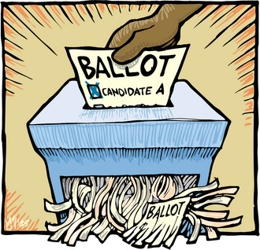
What Is Totalitarianism?
Totalitarianism - form of government in which one person or political party exercises absolute control over all spheres of human life and prohibits opposing political parties
Notes:
Totalitarianism is a form of government in which one person or political party exercises absolute control over all spheres of human life and opposing political parties are prohibited (Communist, theocratic, tribal, right wing).

Slide 21
What Is Totalitarianism?
Four major forms of totalitarianism exist today
Communist totalitarianism – found in states where the communist party monopolizes power (China, North Korea, Cuba)
Theocratic totalitarianism - found in states where political power is monopolized by a party, group, or individual that governs according to religious principles. Iran and Saudi Arabia
Tribal totalitarianism - found in states where a political party that represents the interests of a particular tribe monopolizes power. Zimbabwe, Kenya, Tanzania.
Right-wing totalitarianism - permits some individual economic freedom, but restricts individual political freedom. South korea, Taiwan (1980)
Notes:
Totalitarianism denies its citizens all of the constitutional guarantees asserted by representative democracies.

Slide 22
What Is The Link Between Political Ideology and Economic Systems?
Political ideology and economic systems are connected
countries that stress individual goals are likely to have market based economies
in countries where state-ownership is common, collective goals are dominant
Notes:
The democratic–totalitarian dimension is not independent of the collectivism–individualism dimension. Democracy and individualism go hand in hand, as do the communist version of collectivism and totalitarianism.
However, gray areas exist; it is possible to have a democratic state where collective values predominate, and it is possible to have a totalitarian state that is hostile to collectivism and in which some degree of individualism—particularly in the economic sphere—is encouraged. For example, China has seen a move toward greater individual freedom in the economic sphere, but the government is still a totalitarian dictatorship.

Slide 23


Notes:
https://edition.cnn.com/2019/08/13/asia/hong-kong-airport-protest-explained-hnk-intl/index.html
https://www.bbc.com/news/world-asia-china-48607723

Slide 24
Lecture Outcomes
To understand the different legal Systems
To analyze the operational concerns of different legal systems
To find opportunity gap of different technological environment

Slide 25
What Is A Legal System?
Legal system - the rules that regulate behavior along with the processes by which the laws are enforced and through which redress for grievances is obtained
the system in a country is influenced by the prevailing political system
Notes:
LO 3: Understand how the legal systems of countries differ.
Legal systems are the systems of rules or laws that regulate behavior along with the processes by which the laws are enforced and through which redress for grievances is obtained.
The legal system of a country is of immense importance to international business. A country’s laws regulate business practice, define the manner in which business transactions are to be executed, and set down the rights and obligations of those involved in business transactions.

Slide 26
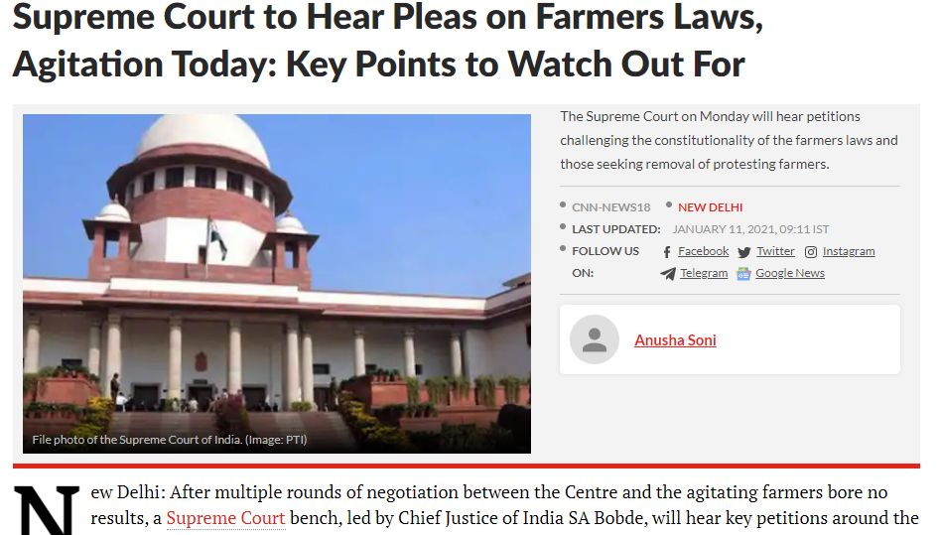

Slide 27
Legal systems are important for business because they
define how business transactions are executed
identify the rights and obligations of parties involved in business transactions

Slide 28
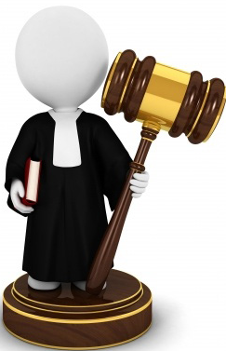
Legal Systems
There are three types of legal systems
Common law
Civic law
Theocratic law
Notes:
There are three main types of legal systems – or legal traditions – in use around the world: common law, civil law, and theocratic law.
Common law evolved in England over hundreds of years. It is now found in most of Great Britain’s former colonies, including the United States. Common law is based on tradition, precedent, and custom. When law courts interpret common law, they do so with regard to these characteristics. This gives a common law system a degree of flexibility that other systems lack because it allows the judge to interpret the law.
Civil law is based on a very detailed set of laws organized into codes. When law courts interpret civil law, they do so with regard to these codes. Over 80 countries, including Germany, France, Japan, and Russia, operate with a civil law system. A civil law system tends to be less adversarial that a common law system, since the judges rely upon detailed legal codes rather than tradition, precedent and custom which they interpret. Judges under a civil law system have less flexibility than those under a common law system.
Theocratic law is based on religious teachings. Islamic law is the most widely practiced theocratic legal system in the modern world, although usage of both Hindu and Jewish law persisted into the twentieth century.

Slide 29
Types of Legal Systems
1.Common Law system: Based on tradition, precedent, custom and usage.
Flexible-Judges have power to interpret the law
Amendment in law with new situations
India, US, Canada ,New Zealand and Australia
Notes:
Country’s legal historylaw
Similar cases that have come and the ways the law are applied for specific situation
Judges

Slide 30
Types of Legal Systems
2. Civil Law:
Detailed set of law organised into codes.
Political officials specify law
Less flexible
Judges have power only to apply the law
Germany, Japan

Slide 31
Types of Legal Systems
3 Theocratic Law: Based on religious and spiritual principles and beliefs
Legal authority given to religious leaders
Eg Islamic law based on Koran
Middle east and northern Africa

Slide 32
Bases of Rules
Rule of Law:
the legal principle that law should govern a nation, as opposed to being governed by arbitrary decisions of individual government officials.
Rule of Man
absence of rule of law. It is a society in which one person, or a group of persons, rules arbitrarily.
Notes:
North Korea –Kim Jong

Slide 33
Operational concerns that face managers worldwide
Starting a business
Entering and enforcing contracts
Hiring and firing local workers
Closing down the business

Slide 34
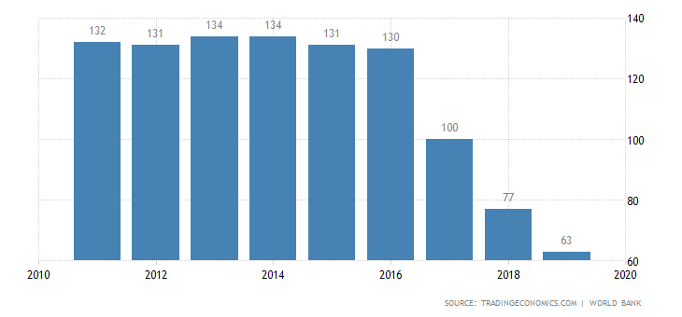
Ease of Doing business

Slide 35

Contracts
Contract - document that specifies the conditions under which an exchange is to occur and details the rights and obligations of the parties involved
Notes:
A contract is a document that specifies the conditions under which an exchange is to occur and details the rights and obligations of the parties involved.
Contract law is the body of law that governs contract enforcement.
The parties to an agreement normally resort to contract law when one party feels the other has violated either the letter or the spirit of an agreement.
Since common law tends to be relatively ill specified, contracts drafted under a common law framework tend to be very detailed with all contingencies spelled out.
In civil law systems, contracts tend to be much shorter and less specific because many of the issues typically covered in a common law contract are already covered in a civil code.
This suggests that it is more expensive to draw up contracts in a common law jurisdiction, and that resolving contract disputes can be a very adversarial process in common law systems.

Slide 36
Contracts Enforced In Different Legal Systems
Contract law is the body of law that governs contract enforcement
under a common law system, contracts tend to be very detailed with all contingencies spelled out
under a civil law system, contracts tend to be much shorter and less specific because many issues are already covered in the civil code

Slide 37
Property Rights
Property rights - the legal rights over the use to which a resource is put and over the use made of any income that may be derived from that resource
Notes:
Property rights refer to a resource over which an individual or business holds a legal title; that is, a resource that they own.
Resources include land, buildings, equipment, capital, mineral rights, businesses, and intellectual property (such as patents, copyrights and trademarks).
Countries differ significantly in the extent to which their legal system protects property rights.

Slide 38
Intellectual Property Protection
Intellectual property - property that is the product of intellectual activity
Can be protected using
Patents – exclusive rights for a defined period to the manufacture, use, or sale of that invention
Copyrights – the exclusive legal rights of authors, composers, playwrights, artists, and publishers to publish and disperse their work as they see fit
Trademarks – design and names by which merchants or manufacturers designate and differentiate their products
Notes:
Management Focus: Starbucks Wins Key Trademark Case in China focuses on intellectual property laws in China. When Starbucks entered China in 1999, the company was quickly challenged by a look-alike competitor, Xing Ba Ke. Not only did the name Xing Ba Ke mimic the Starbucks name, but Xing Ba Ke’s stores were virtual replicas of those operated by Starbucks. In 2003, Starbucks sued Xing Ba Ke for trademark violations. In 2006, Starbucks won its case, and Xing Ba Ke was fined $62,000 and ordered to stop using its name. The case was seen as a break through of sorts, a signal that China was finally caving to pressure from other nations and the World Trade Organization to respect intellectual property rights. Today, Starbucks operates over 400 stores in China and expects the market to become second only to the United States.

